Slide 1
Hashtables
Thanks to David Kauchak

Slide 2
Data structures so far
When would we use:
  Arrays
    get and set particular indices in constant time
  linked list
    insert and delete in constant time
  stack
    LIFO
  queue
    FIFO

Slide 3
Data structures so far
When would we use:
  heap
    max/min in log time
  BST
    search in log time
  B-Tree
    search on disk in log disk accesses

Slide 4
Hashtables
Constant time insertion and search (and deletion in some cases) for a large space of keys
Applications
  Does x belong to S?
  I’ve found them very useful
  compilers
  databases
  search engines
  storing and retrieving non-squential data
  save memory over an array

Slide 5
Key/data pair
The key is a numeric representation of a relevant portion of the data
For example:
data
key
integer
number

Slide 6
Key/data pair
The key is a numeric representation of the relevant portion of the data
For example:
data
key
ascii code
string
number

Slide 7
Key/data pair
The key is a numeric representation of the relevant portion of the data
For example:
ascii code of first and last name
key
data
account information
number

Slide 8
Why not just arrays aka direct-address tables?
array must be as large as the universe of keys
universe of keys - U
Array

Slide 9
Why not just arrays?
array must be as large as the universe of keys
universe of keys - U
space of actual keys is often much smaller than the actual keys
actual
keys, n
Array

Slide 10
Why not arrays?
Think of indexing all last names < 10 characters
  Census listing of all last names (http://www.census.gov/genealogy/names/dist.all.last)
    88,799 last names
  All possible entries:
    26¹⁰ = a big number
  Not feasible!
  Even if it were, not space efficient

Slide 11
The load of a table/hashtable
m = number of possible entries in the table
n = number of keys stored in the table
α = n/m is the load factor of the hashtable
For example
  α = 88,799 / 26¹⁰ would be the load factor of last names using direct-addressing
The smaller α, the more wasteful the table
The load also helps us talk about run time

Slide 12
Hash function, h
A hash function is a function that maps the universe of keys to the slots in the hashtable
universe of keys - U
hash function, h
m << |U|

Slide 13
Hash function, h
A hash function is a function that maps the universe of keys to the slots in the hashtable
universe of keys - U
hash function, h
m << |U|

Slide 14
Hash function, h
A hash function is a function that maps the universe of keys to the slots in the hashtable
universe of keys - U
hash function, h
m << |U|

Slide 15
Hash function, h
What can happen if m ≠ |U|?
universe of keys - U
hash function, h
m << |U|

Slide 16
Collisions
If m ≠ |U|, then two keys can map to the same position in the hashtable
universe of keys - U
hash function, h
m << |U|

Slide 17
Collisions
A collision occurs when h(x) = h(y), but x ≠ y
A good hash function will minimize the number of collisions
Because the number of hashtable entries is less than the possible keys (i.e. m < |U|) collisions are inevitable!

Slide 18
Collision resolution by chaining
Hashtable consists of an array of linked lists
When a collision occurs, the element is added to linked list at that location
If two entries x ≠ y have the same hash value h(x) = h(x), then T(h(x)) will contain a linked list with both values

Slide 19

Insertion
ChainedHashInsert( )

Slide 20
Insertion
h( )
hash function is a mapping from the key to some value < m

Slide 21
Insertion
h( )

Slide 22

Deletion
pass in a pointer not the value

Slide 23
Deletion

Slide 24
Deletion

Slide 25

Search
ChainedHashSearch( )

Slide 26
Search
h( )

Slide 27
Search
ChainedHashSearch( )

Slide 28
Search
ChainedHashSearch( )

Slide 29
Search
ChainedHashSearch( )

Slide 30
Running time
Θ(1)
Θ(1)
assuming?
O(length of the chain)

Slide 31
Length of the linked lists
Worst case?

Slide 32
Length of the chain
Worst case?
  All elements hash to the same location
  h(k) = 4
  O(n)
…

Slide 33
Length of the chain
Average case
  Depends on how well the hash function distributes the keys
  Assume simple uniform hashing: an element is equally likely to end up in any of the m slots
  Under simple uniform hashing what is the average length of a chain in the table?
    n keys over m slots = n / m = α

Slide 34
Average chain length
If you roll a fair m sided die n times, how many times are we likely to see a given value?
For example, 10 sided die:
  1 time
    1/10
  100 times
    100/10 = 10

Slide 35
Search average running time
Two cases:
  Key is not in the table
    must search all entries
    Θ(1 + α)
  Key is in the table
    on average search half of the entries
    O(1 + α)

Slide 36
Hash functions
What makes a good hash function?
  Approximates the assumption of simple uniform hashing
  Deterministic – h(x) should always return the same value
  Low cost – if it is expensive to calculate the hash value (e.g. log n) then we don’t gain anything by using a table
Challenge: we don’t generally know the distribution of the keys
  Frequently data tend to be clustered (e.g. similar strings, run-times, SSNs). A good hash function should spread these out across the table

Slide 37
Division method
h(k) = k mod m
M K h(k)
11 25
3
11 1
1
11 17
6
13 133
3
13 7
7
13 25
12

Slide 38
Division method
Don’t use a power of two. Why?
if h(k) = k mod 2^{p}, the hash function is just the lower p bits of the value
m k bin(k) h(k)
25 11001 1
8 1 00001 1
8 17 10001 1

Slide 39
Division method
Good rule of thumb for m is a prime number not to close to a power of 2
Pros:
  quick to calculate
  easy to understand
Cons:
  keys close to each other will end up close in the hashtable

Slide 40
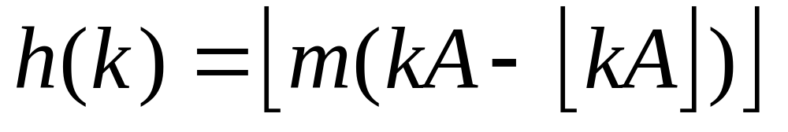
Multiplication method
Multiply the key by a constant 0 < A < 1 and extract the fractional part of kA, then scale by m to get the index
extracts the fractional portion of kA

Slide 41
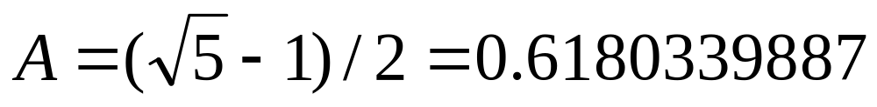
Multiplication method
Common choice is for m as a power of 2 and
Why a power of 2?
Book has other heuristics

Slide 42
Multiplication method
m k A
8 15 0.618
8 23 0.618
8 100 0.618
kA h(k)
9.27
floor(0.27*8) = 2
14.214
floor(0.214*8) = 1
61.8
floor(0.8*8) = 6

Slide 43
Other hash functions
http://en.wikipedia.org/wiki/List_of_hash_functions
cyclic redundancy checks (i.e. disks, cds, dvds)
Checksums (i.e. networking, file transfers)
Cryptographic (i.e. MD5, SHA)

Slide 44
Open addressing
Keeping around an array of linked lists can be inefficient and a hassle
Like to keep the hashtable as just an array of elements (no pointers)
How do we deal with collisions?
  compute another slot in the hashtable to examine

Slide 45
Hash functions with open addressing
Hash function must define a probe sequence which is the list of slots to examine when searching or inserting
Hash function takes an additional parameter i which is the number of collisions that have already occurred
The probe sequence must be a permutation of every hashtable entry. Why?
{ h(k,0), h(k,1), h(k,2), …, h(k, m-1) } is a permutation of
{ 0, 1, 2, 3, …, m-1 }

Slide 46
Probe sequence
h(k, 0)

Slide 47
Probe sequence
h(k, 1)

Slide 48
Probe sequence
h(k, 2)

Slide 49
Probe sequence
h(k, 3)

Slide 50
Probe sequence
h(k, …)
must visit all locations
…

Slide 51
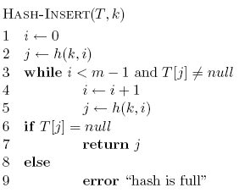
Open addressing: Insert

Slide 52
Open addressing: Insert
get the first hashtable entry to look in

Slide 53
Open addressing: Insert
follow the probe sequence until we find an open entry

Slide 54
Open addressing: Insert
return the open entry

Slide 55
Open addressing: Insert
hashtable can fill up

Slide 56
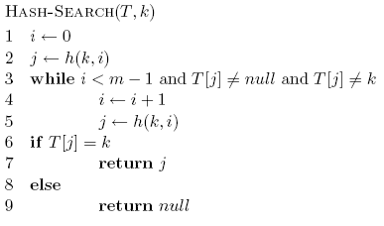
Open addressing: search

Slide 57
Open addressing: search

Slide 58
Open addressing: delete
What happens if we simple delete a node?
“breaks” the probe sequence

Slide 59
Open addressing: delete
Two options:
  mark node as “deleted” (rather than null)
    modify search procedure to continue looking if a “deleted” node is seen
    modify insert procedure to fill in “deleted” entries
    increases search times
  if a lot of deleting will happen, use chaining

Slide 60
Probing schemes
Linear probing – if a collision occurs, go to the next slot
  h(k,i) = (h(k) + i) mod m
  Does it meet our requirement that it visits every slot?
  for example, m = 7 and h(k) = 4
h(k,0) = 4
h(k,1) = 5
h(k,2) = 6
h(k,3) = 0
h(k,3) = 1

Slide 61
Linear probing: search
h( , 0)

Slide 62
Linear probing: search
h( , 1)

Slide 63
Linear probing: search
h( , 2)

Slide 64
Linear probing: search
h( , 3)

Slide 65
Linear probing: search
h( , 3)

Slide 66
Linear probing
Problem:
  primary clustering – long rungs of occupied slots tend to build up and these tend to grow
any value here results in an increase in the cluster
become more and more probable for a value to end up in that range

Slide 67
Quadratic probing
h(k,i) = (h(k) + c₁i + c₂i²) mod m
Rather than a linear sequence, we probe based on a quadratic function
Problems:
  must be constants and m so that we have a proper probe sequence
  if h(x) = h(y), then h(x,i) = h(y,i) for all i
  secondary clustering

Slide 68
Double hashing
Probe sequence is determined by a second hash function
h(k,i) = (h₁(k) + i(h₂(k)) mod m
Problem:
  h₂(k) must visit all possible positions in the table

Slide 69
Running time of insert and search for open addressing
Depends on the hash function/probe sequence
Worst case?
  O(n) – probe sequence visits every full entry first before finding an empty

Slide 70
Running time of insert and search for open addressing
Average case?
We have to make at least one probe

Slide 71
Running time of insert and search for open addressing
Average case?
What is the probability that the first probe will not be successful?
α

Slide 72
Running time of insert and search for open addressing
Average case?
What is the probability that the first two probed slots will not be successful?
~α²
why ‘~’?

Slide 73
Running time of insert and search for open addressing
Average case?
What is the probability that the first three probed slots will not be successful?
~α³

Slide 74
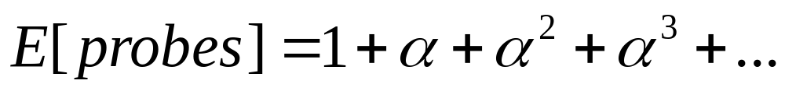
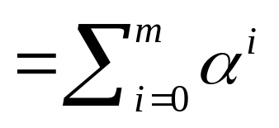
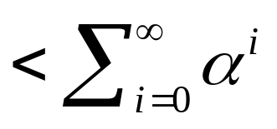
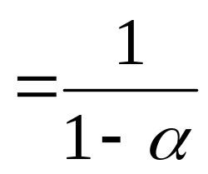
Running time of insert and search for open addressing
Average case: expected number of probes
  sum of the probability of making 1 probe, 2 probes, 3 probes, …

Slide 75
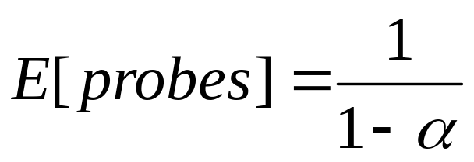
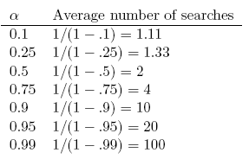
Average number of probes

Slide 76
How big should a hashtable be?
A good rule of thumb is the hashtable should be around half full
What happens when the hashtable gets full?
  Copy: Create a new table and copy the values over
    results in one expensive insert
    simple to implement
  Amortized copy: When a certain ratio is hit, grow the table, but copy the entries over a few at a time with every insert
    no single insert is expensive and can guarantee per insert performance
    more complicated to implement

